Slide 1

Machine Learning Model Deployment with IBM Cloud Watson Studio
By
gobika.r
Gomathi . M
hemamalini . S
janarthini . S
Jayasri . s

Slide 2
Problem Statement
Become a wizard of predictive analytics with IBM Cloud Watson Studio. Train machine learning models to predict outcomes in real-time. Deploy the models as web services and integrate them into your applications. Unlock the magic of data-driven insights and make informed decisions like never before!
The project involves training a machine learning model using IBM Cloud Watson Studio and deploying it as a web service. The goal is to become proficient in predictive analytics by creating a model that can predict outcomes in real-time. The project encompasses defining the predictive use case, selecting a suitable dataset, training a machine learning model , deploying the model as a web service, and integrating it into applications.

Slide 3
Abstract
Machine Learning (ML) has become an integral part of modern software development, enabling applications to learn patterns from data and make intelligent decisions. IBM Watson Studio, a comprehensive platform, provides developers with powerful tools to streamline the ML development lifecycle. This paper explores the process of ML model development using IBM Watson Studio, from data preparation to deployment. It highlights key features, methodologies, and best practices, demonstrating how Watson Studio facilitates efficient and effective ML development.

Slide 4

Design Thinking
Predictive Use Case
Define a use case for predictive analytics, such as predicting customer churn or product demand.

Slide 5

Design Thinking
Dataset Selection
Choose a relevant dataset to train the machine learning model.

Slide 6

Design Thinking
Model Training
Select a suitable machine learning algorithm and train the model using IBM Cloud Watson Studio.

Slide 7
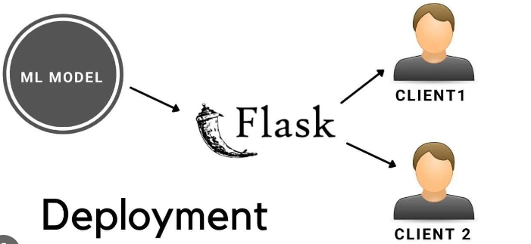
Design Thinking
Model Deployment
Deploy the trained model as a web service using IBM Cloud Watson Studio's deployment capabilities.

Slide 8

Design Thinking
Integration
Integrate the deployed model into applications or systems to make real time predictions.

Slide 9

Automating Model Deployment
Automating Model Deployment With IBM Cloud Watson Studio, you can automate your model deployment process with just a few clicks. This saves you time and reduces errors. You can also monitor your models and update them easily.

Slide 10

Existing
IBM Cloud Watson Studio has been used by companies such as Walmart, KPMG, and Airbnb to streamline their machine learning model deployment process. They have saved time and increased productivity.

Slide 11
Conclusion
IBM Watson Studio empowers developers and data scientists to navigate the complexities of ML model development efficiently. Its robust features for data preparation, model training, evaluation, deployment, and maintenance streamline the end-to-end process. By leveraging Watson Studio's capabilities, organizations can accelerate innovation, gain valuable insights from data, and deliver intelligent applications that drive business growth. Embracing IBM Watson Studio in the ML development workflow ensures that modern applications are equipped with the intelligence necessary to meet the evolving needs of users and businesses alike.

Slide 12
THANK YOU

